Slide 1
Multimodal tokenization
Neil Getty

Slide 2
Understanding multimodal nomenclature

Slide 3
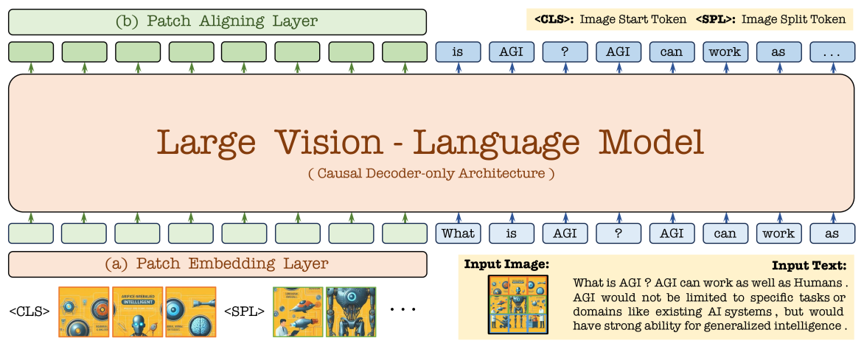
“Pure” multimodal
Encoder free, modality directly input to model
https://arxiv.org/html/2406.11832v1

Slide 4
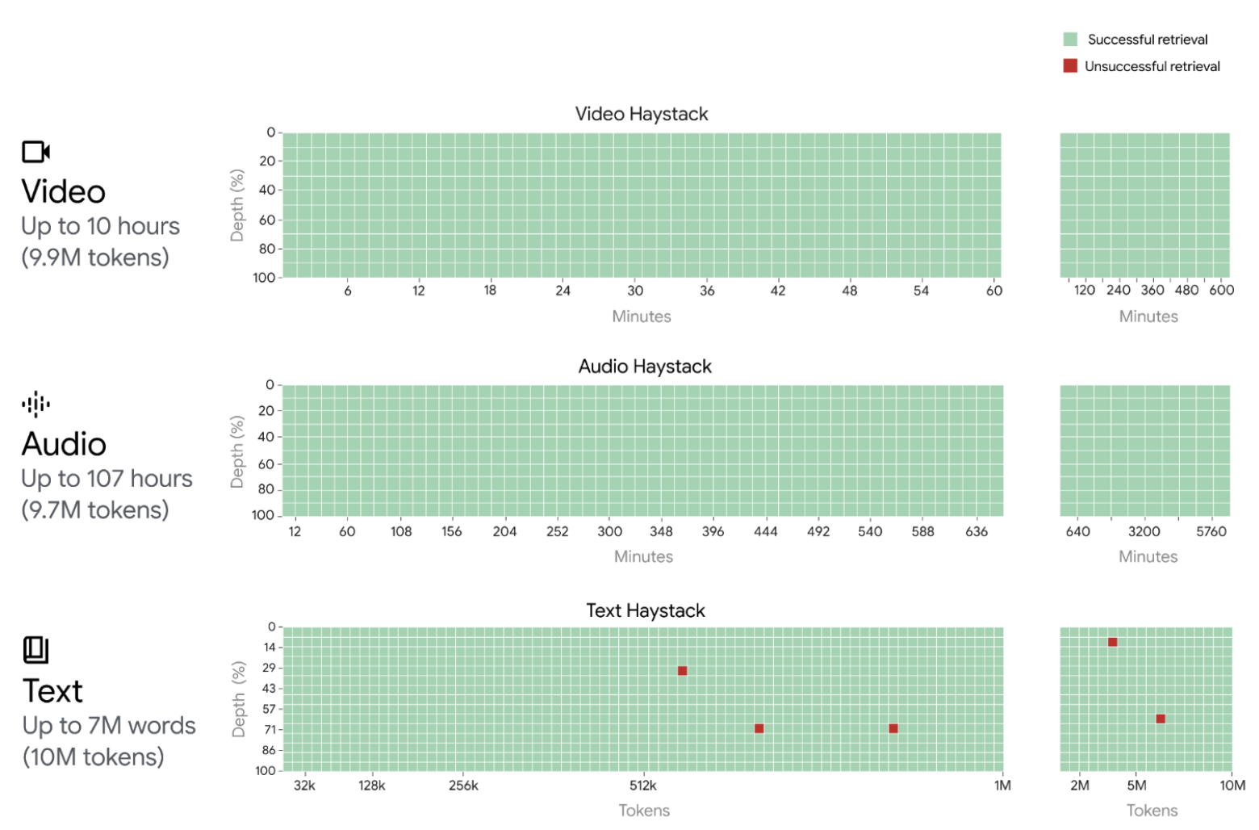
“Native” multimodal
Gemini, GPT 4o: encoder based, multimodal introduced during retraining
https://arxiv.org/pdf/2403.05530

Slide 5
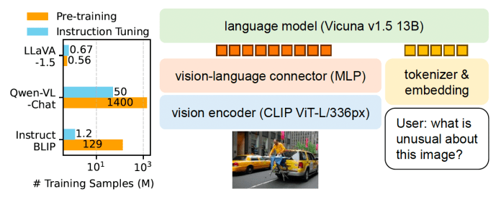
Multimodal finetuning (impure?)
LLaVA, Flamingo (cross-attention): encoder based, multimodal introduced as fine-tuning step
https://arxiv.org/pdf/2304.08485

Slide 6
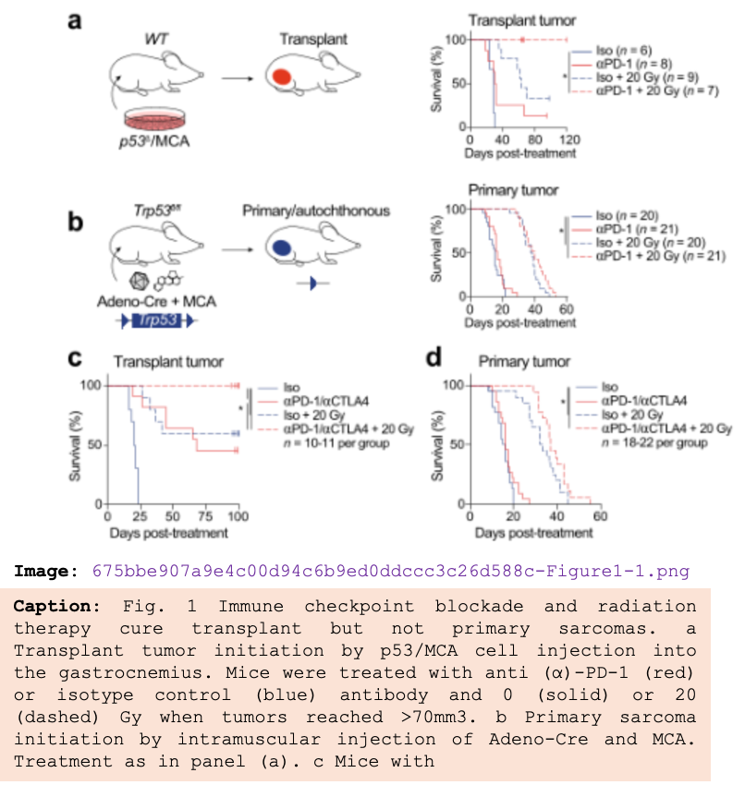
Finetuning is relatively cheap and effective
Trained on 170k image/captions from 40k low dose radiation therapy papers
 | Detail |  | Complex |  | Overall
 | Mean | Std | Mean | Std | Mean | Std
llava_v1.5 | 1.74 | 0.79 | 5.48 | 2.37 | 3.46 | 2.53
lucid_v1.5 | 4.10 | 2.90 | 6.63 | 2.66 | 5.26 | 3.06
Improvement | 135.2% |  | 21.1% |  | 52.1%
llava_v1.6 | 4.14 | 2.28 | 2.66 | 2.12 | 3.34 | 2.32
lucid_v1.6 | 6.52 | 2.49 | 2.43 | 2.28 | 4.31 | 3.14
Improvement | - 8.7% |  | 57.5% |  | 29.1%

Slide 7
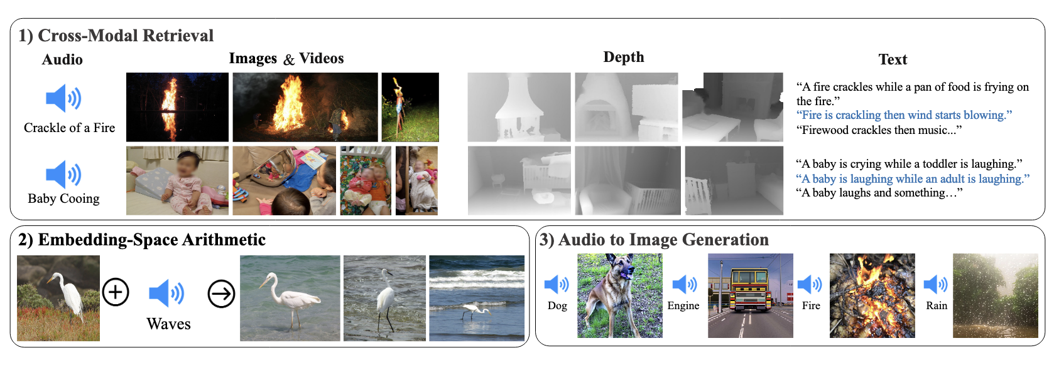
The need for a “binding” modality
Data is rarely omnimodal
https://arxiv.org/pdf/2305.05665

Slide 8
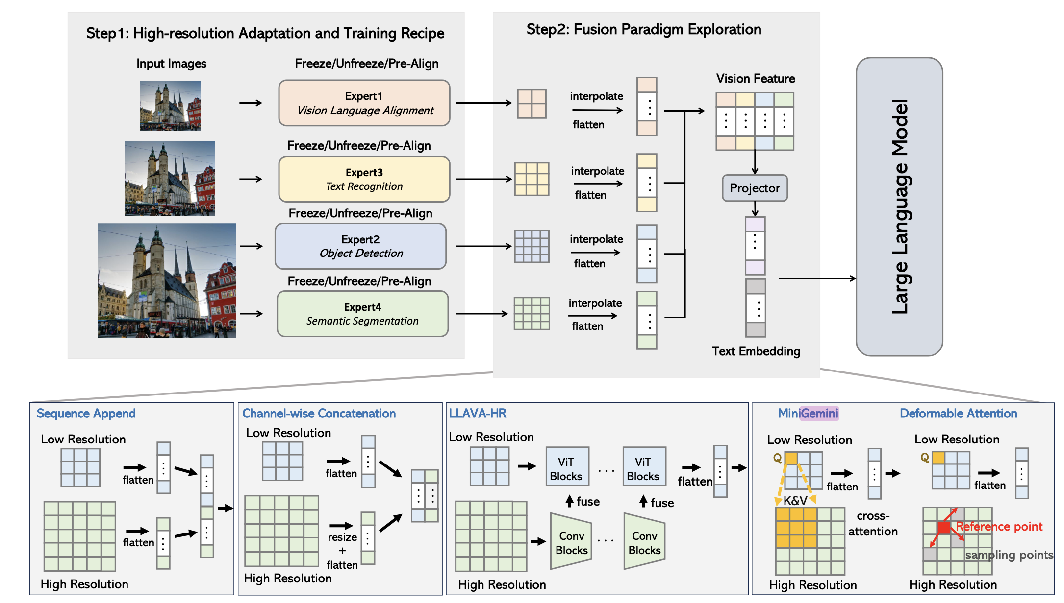
Encoder or Encoders?
https://arxiv.org/pdf/2408.15998

Slide 9
Do we need modality tokenizers?
Yes, probably
Need to define and justify scientific modalities beyond text, vision, audio
Is a dataset an additional modality, or just out of distribution?
Are there sufficient pairs of multimodal observations?
Do we need Omni models, or is multi-multi sufficient?
If we want to take a “native” approach, we should start today

